Slide 1


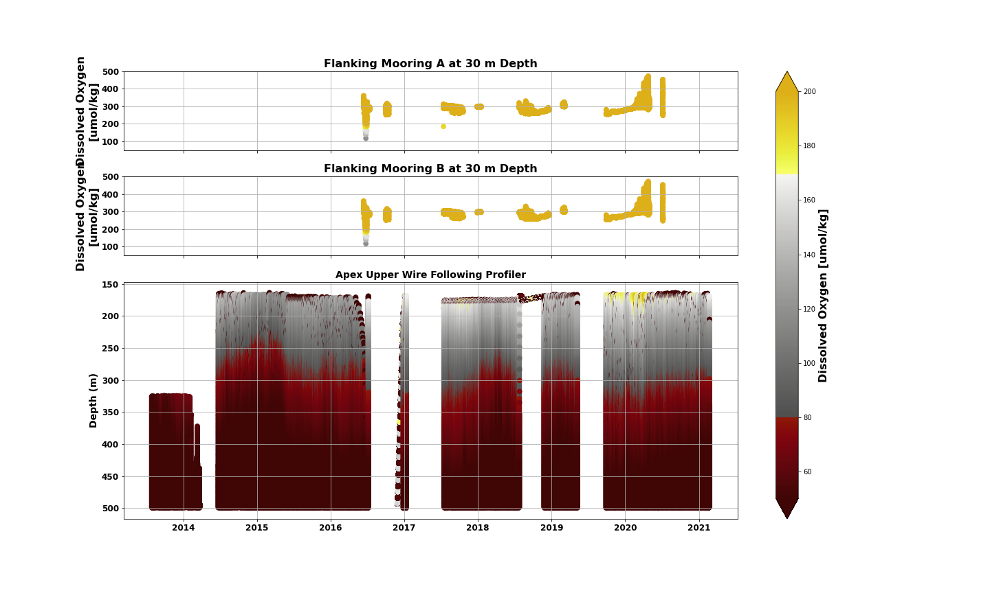
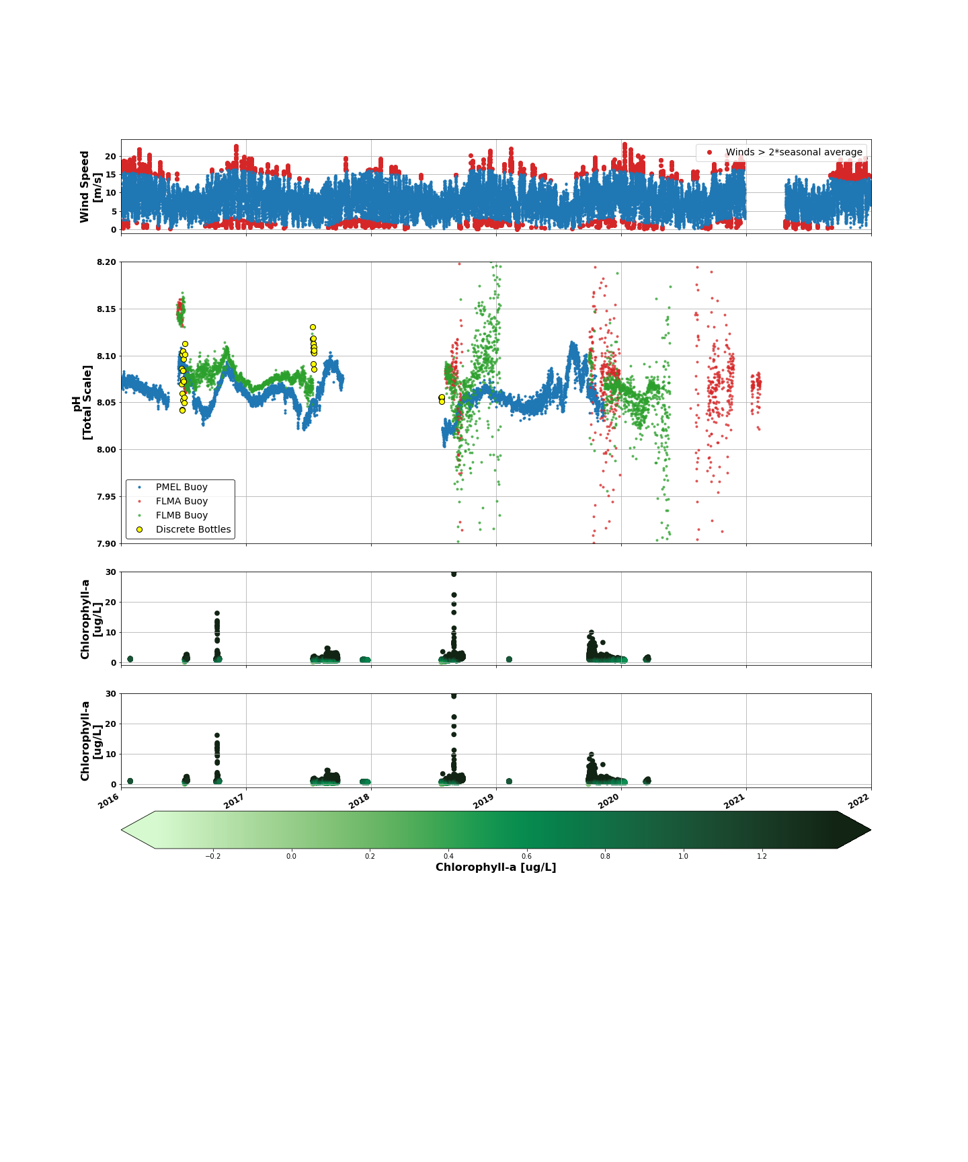
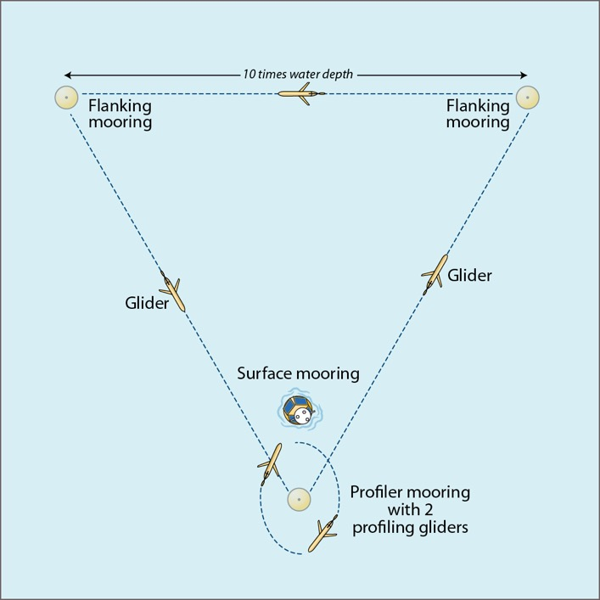
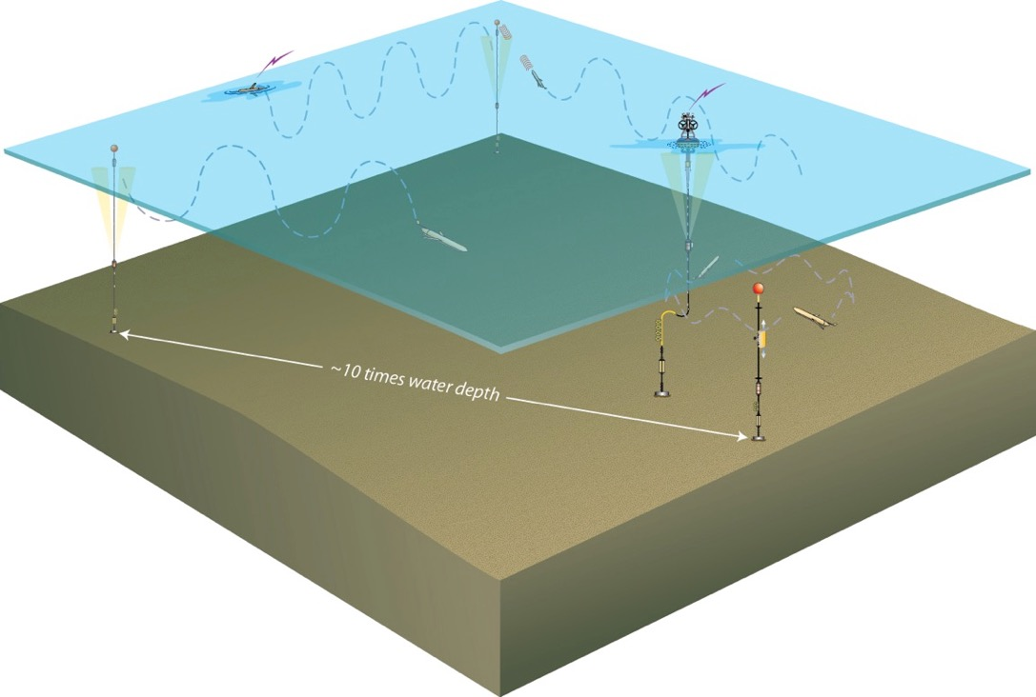
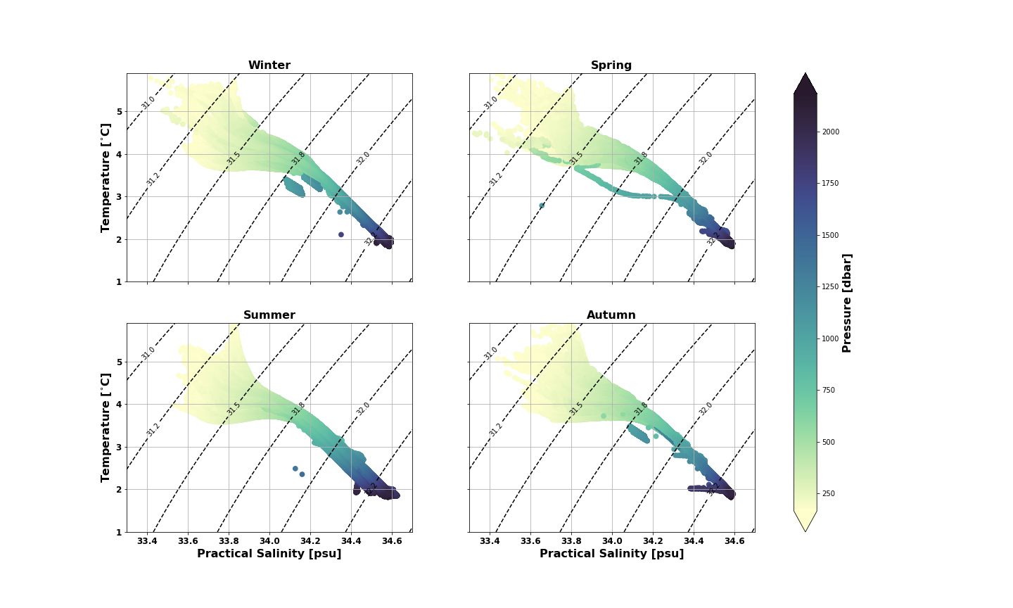
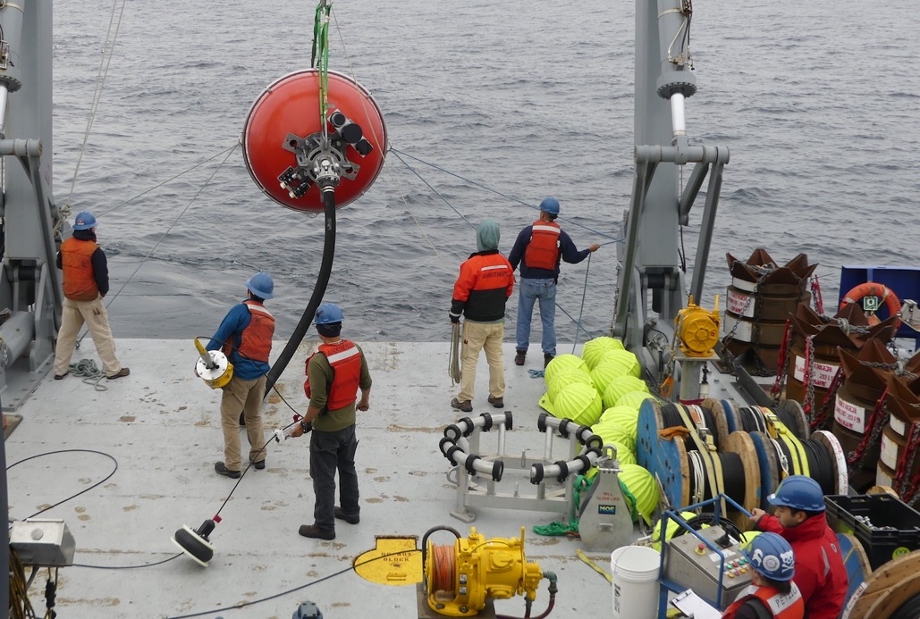
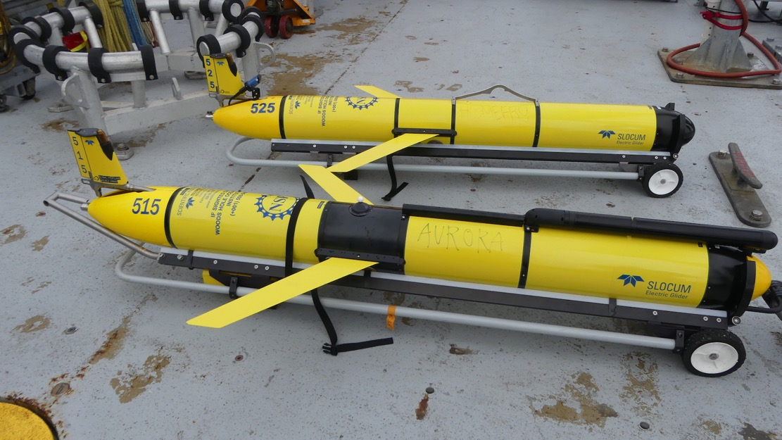
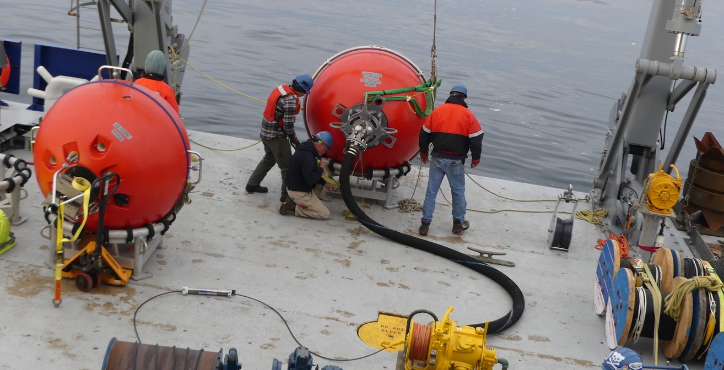
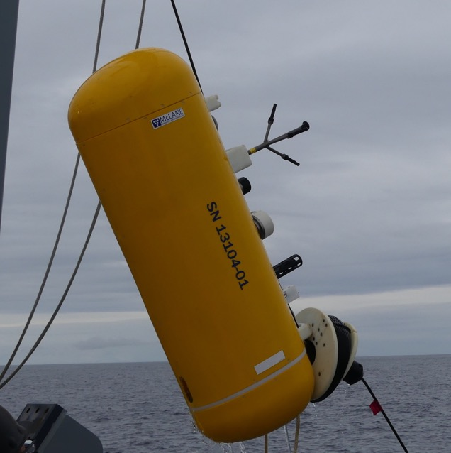

Global Ocean Station Papa: Assets & Datasets
Andrew Reed: OOI - Coastal & Global Scale Nodes Group
Science Themes
Available Data
Example Data Visualization
Climate Variability, Ocean Food Webs, and Biogeochemical Cycling
A compelling driver for the multidisciplinary and biogeochemical observations at Ocean Station Papa is understanding how climate variability will affect ocean food webs, weather patterns, the ocean’s biochemical environment and marine ecosystems.
Turbulent Mixing and Biophysical Interactions
Turbulent mixing plays a critical role in the transfer of materials within the ocean and in the exchange of energy and gases between the ocean and atmosphere. Additionally, horizontal and vertical mixing within the ocean can have a profound effect on a wide variety of biological processes.
Ocean-Atmosphere Exchange
Quantifying the air-sea exchange of energy and mass, especially during high winds (greater than 20 ms⁻¹), is critical to providing estimates of energy and gas exchange between the surface and deep ocean and to improving the predictive capability of storm forecasting and climate-change models. Ocean Station Papa investigates these questions by collecting complementary data to NOAA’s PMEL Carbon Buoy.
Depth (m) | Instrument / Measurement | Samples
 |  | O2/Salts | Carbon | Nitrates | Chlorophyll
Flanking Moorings
surf |  | Optional
30 | CTD, DO, Flor, pH |  | DIC/TA, pH | Optional
40 | CTD | Optional
Chl max
60 | CTD
90 | CTD
130 | CTD |  |  | Optional
180 | CTD | Optional
250 | CTD
350 | CTD | Optional
500 | CTD, ADCP
750 | CTD | Optional
1000 | CTD
1500 | CTD
~bottom
Global Hybrid Profiler Mooring
surf |  | Optional
30 |  | Optional | DIC/TA, pH
Chl max
150 | CTD, Zooplankton |  |  |  | If fluor sig.
156-2090 | Profiler – CTD, DO, Flor, Velocity | 400-600 m increments
2129-4063 | Profiler – CTD, DO, Flor, Velocity | 400-600 m increments
Gliders
surf | Global Profiling Glider (GPG) – CTD, DO, Flor, Nitrate, PAR Open Ocean Glider – CTD, DO, Flor |  |  | GPG
30 |  |  |  | GPG
50 |  |  |  | GPG
100 |  |  |  | GPG
200 |  |  |  | GPG | If fluor sig.
300-1000 |  | 100 m increments
Assets
Figure 3. Dissolved oxygen concentrations collected by the OOI Flanking Mooring A (top), Flanking Mooring B (middle), and the Upper Wire Following Profiler (bottom).
At Station Papa, OOI deploys two Subsurface Flanking Moorings A & B (GP03FLMA & GP03FLMB), an Apex Profiler Mooring (GP02HYPM), and gliders as complements to NOAA’s surface assets. Flanking moorings are equipped with oxygen, chlorophyll, and pH sensors at 30 m, as well as CTDs at regular intervals from 30 m to 1500 m, and an ADCP for the upper 500 m. The profilers (shallow from 156 to 2090 m and deep from 2129 to 4063 m) are equipped with CTD, oxygen, chlorophyll. The top sphere is equipped with a zooplankton sensor.
Table 1. Table of available datasets on different platforms at the OOI Papa array along with discrete water sampling, which occurs during deployment/recovery.
Figure 1 - Top: Schematic of a global array. Bottom (clockwise from top left): A global hybrid wire-following-profile mooring being deployed; two global open ocean gliders; a global surface mooring being deployed; a wire-following profiler.
Figure 4. Example of integrating physical & biogeochemical datasets from different sources to address potential questions for some of the major science themes. (Top) NOAA PMEL’s surface buoy met measurements; (Middle) Seawater pH from both OOI Flanking Moorings & PMEL buoy along with discrete bottle measurements; (Bottom) Chlorophyll-a concentrations from OOI Flanking Moorings.
Notes: Figure 1 photos by Rebecca Travis & Andrew Reed. Table 1 adapted from OOI-CGSN water sampling SOP by Sheri White. Data for Figures 2, 3, & 4 downloaded from ooinet.oceanobservatories.org via M2M API. Scripts available at github.com/reedan88/OOI-NE-Community-Workshop. Water sampling data available at alfresco.oceanobservatories.org.
Figure 2. Temperature-Salinity diagrams with pressure from the Upper Wire Following Profiler divided by season.
Notes:
Apex profiler: Bio-acoustic Sonar instruments (ZPLSG) to sense zooplankton in the upper ~300 meters
Flanking Moorings: ADCP for the upper 500 meters

